Slide 1

先进封装与集成芯片 Advanced Package and Integrated Chips
Lecture 9 : SoC/Chiplet Interconnect
Instructor: Chixiao Chen, Ph. D

Slide 2
Course Project
Option I: Presentation ( I guess most students would choose )
Pick up one paper from the pool (https://365.kdocs.cn/l/cpbY4B34cUnj first come first served), send a email or told me in wechat group, I will updated the paper selection in time.
If you want to pick a paper not listed, please send me an email to get granted.
Slides and Presentation: Prepare a 15min slides to introduce the work and 3-5 min Q&A. Send the slides to the homework mail after presentation.
Option II: Project
Complete a component (AXI-streaming controller+PCS, PHY-TX/RX pair, Clock Generation, ) design according to UCIe standard (not in a group)
Report and Presentation: Prepare a 5 min introduction and send the design report (<10 pages A4) to the homework mail, NO need for slides, show your draft report during presentation is OK.
1st Deadline: Tell me your choice by 5.6 on class / mail / wechat.

Slide 3
Overview
Review on SoC Interconnect
Bus based on-chip communication
Network-on-Chips (NoCs)
From SoC Peripherals to Chiplet Interconnect
Case Studies
How advanced packaging affects System Performance

Slide 4
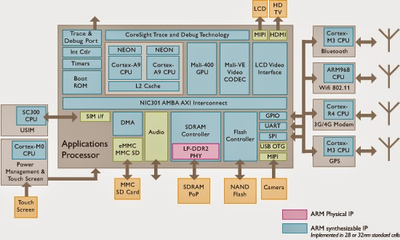
Communication-centric Design for SoC
SoC = System on Chip
For modern SoCs like a smart phone SoC, communication is the most critical aspects.
It affects performance, power, area (PPA) & time-to-market.

Slide 5
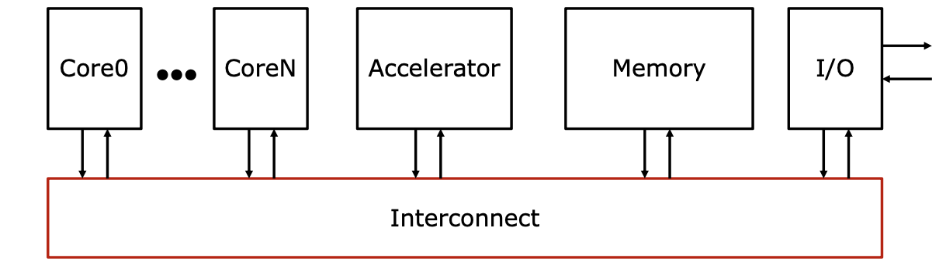
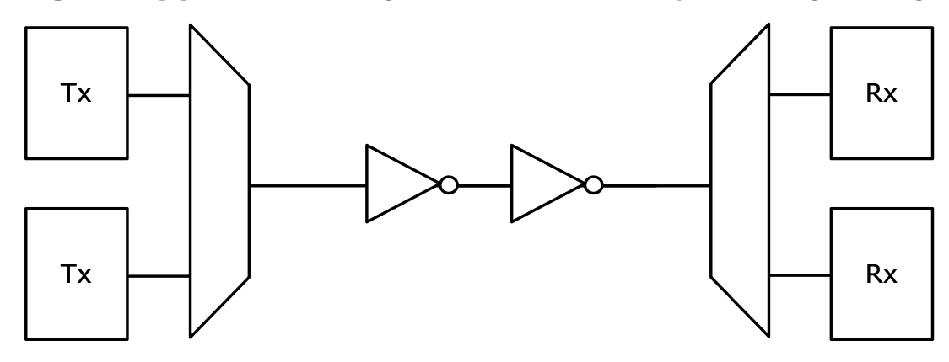
On-Chip Interconnect: Physical and System View
Interconnect: communication infrastructure connecting all IPs together
Physical Implementation Interconnect: to avoid too many wires, we need to multiplex data over a group of shared wires

Slide 6
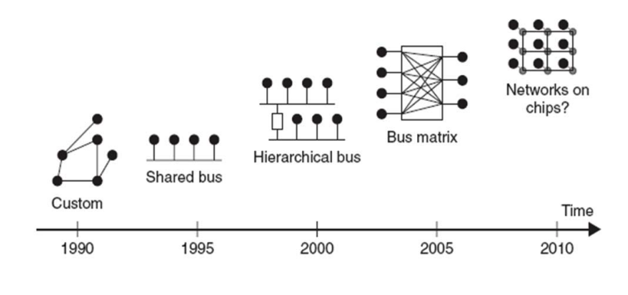

Evolution of on-chip Interconnect
Bus is the most simplest and widely used SoC Interconnect.
Bus definition: A collection of signals to which multiple IPs are connected

Slide 7
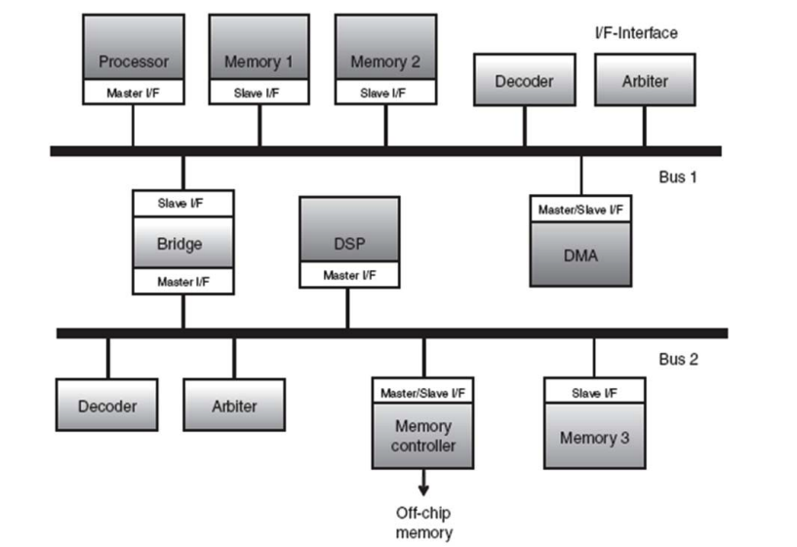
Bus Terminology
Master: IPs tat initiates a read/write data transfer.
Slave: IPs that only responds to incoming transfer requests.
Arbiters: Control bus operation by selecting master to grant data transfers.
Bridge: Connects with different bus, acting as slave one side and master on other side.

Slide 8
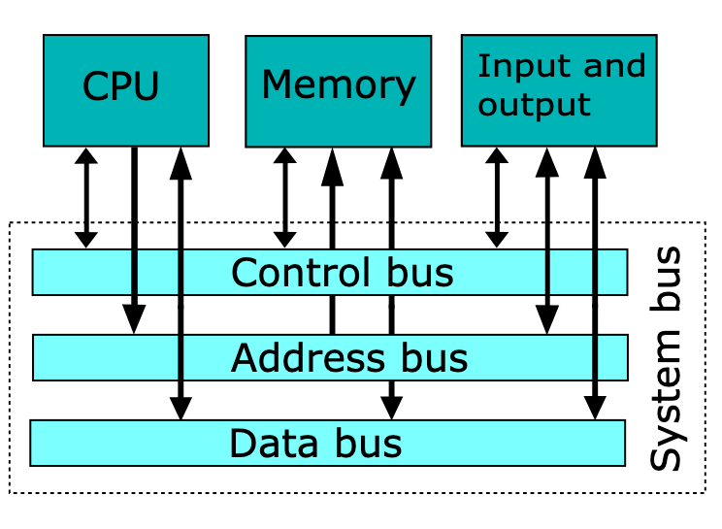
Bus signals
Address: transfer data’s source and destination, uniformed encoded for all on-chip IPs, driven by masters only
Data: real information sent and received by bus, can be shared or separated for read and write
Control: includes request and acknowledgements, specify different type of data transfer (R/W, burst, cacheable, byte mask, …)

Slide 9
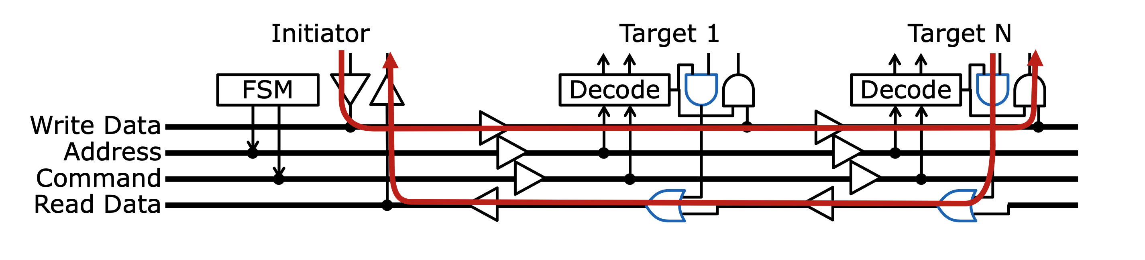
Basic Bus Circuit Implementation (Digital)
Historically tri-state drivers (high impedance to disconnect) is not friendly in recent CMOS digital circuit design.
Current bus implementation adopts differentiate Read & Write Data channels to replace tri-state drivers
Pipelining stage can be inserted to prevent long-distance transition and latency.

Slide 10
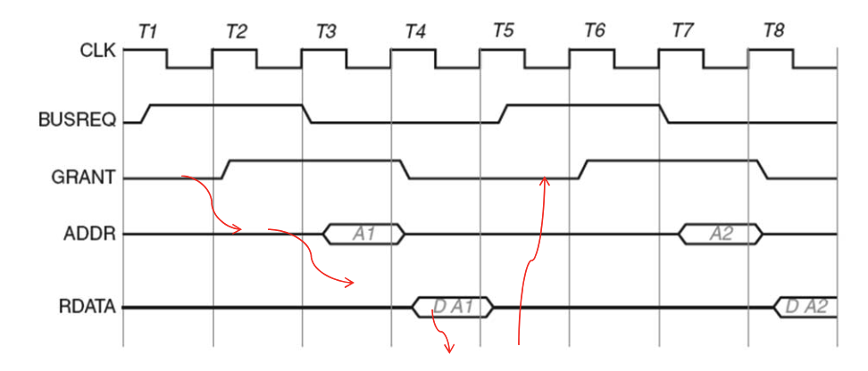
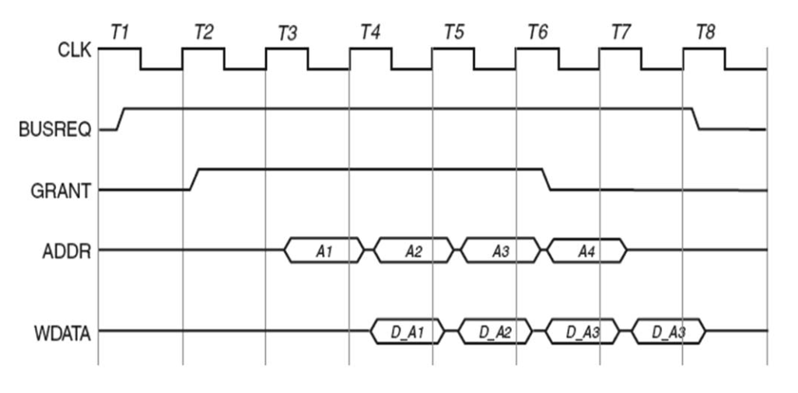
Bus Transfer Modes
Single data transfer (w/o pipeline)
first request to access bus
access granted/acknowledged
sent address and control signals
send/receive data in subsequent cycles
Burst data transfer (w/i pipeline)
send multiple data with only one cycle control ( save time for arbitration)
Continuous data transfer for recent AI applications
There should be a protocol or standard for bus communication.

Slide 11
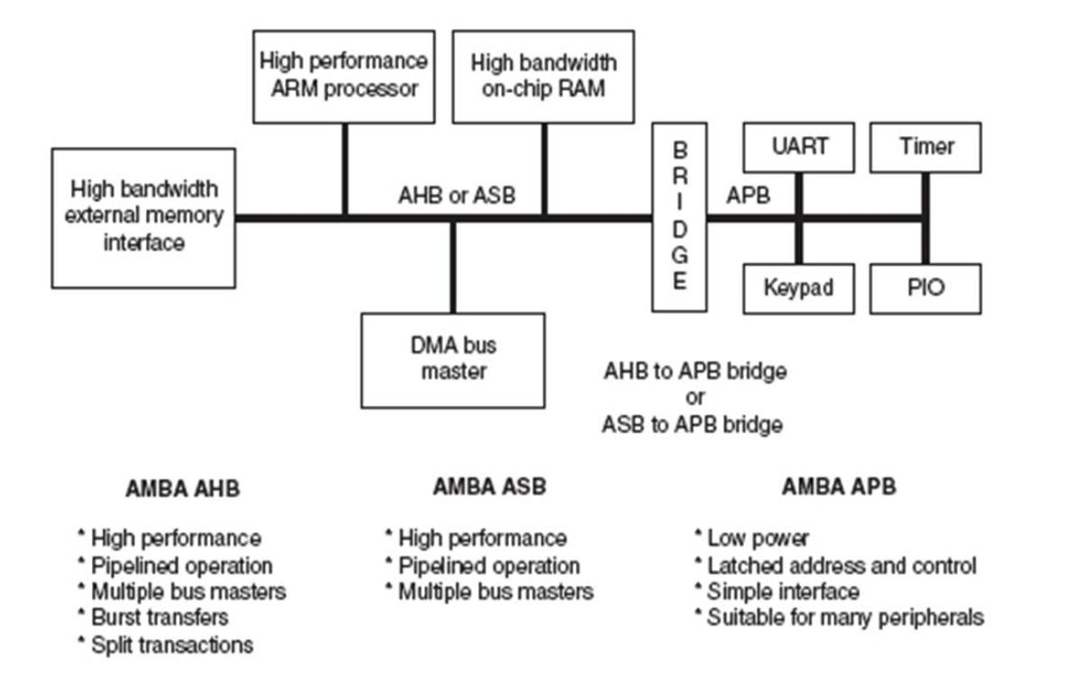
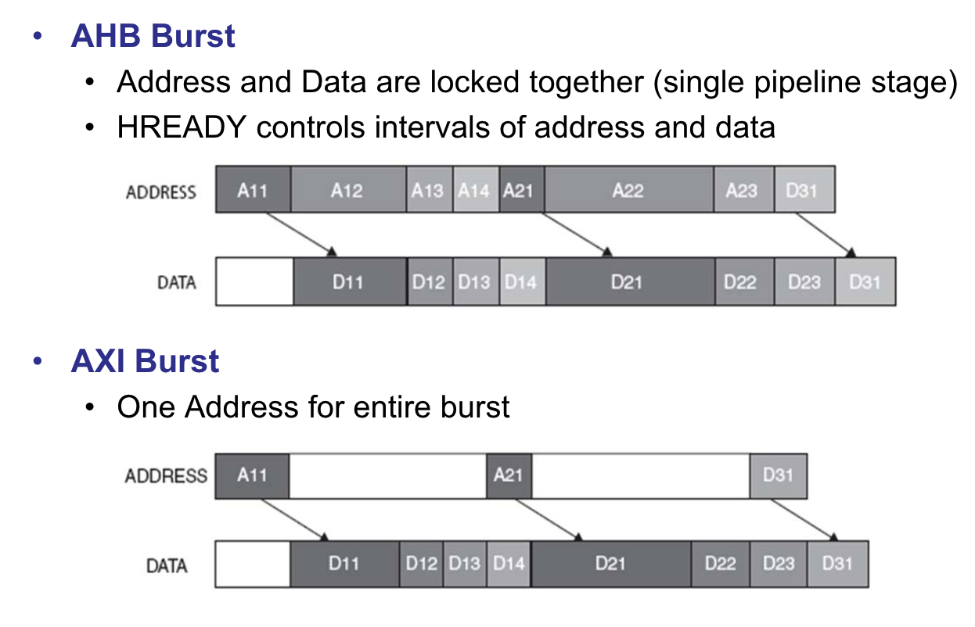
AMBA Bus Protocol
Advanced Microcontroller Bus Architecture, open standard but owned by ARM
AMBA 2: AHB Advanced High-performance Bus, AMB 3&4: AXI Advanced Extensible Interface

Slide 12
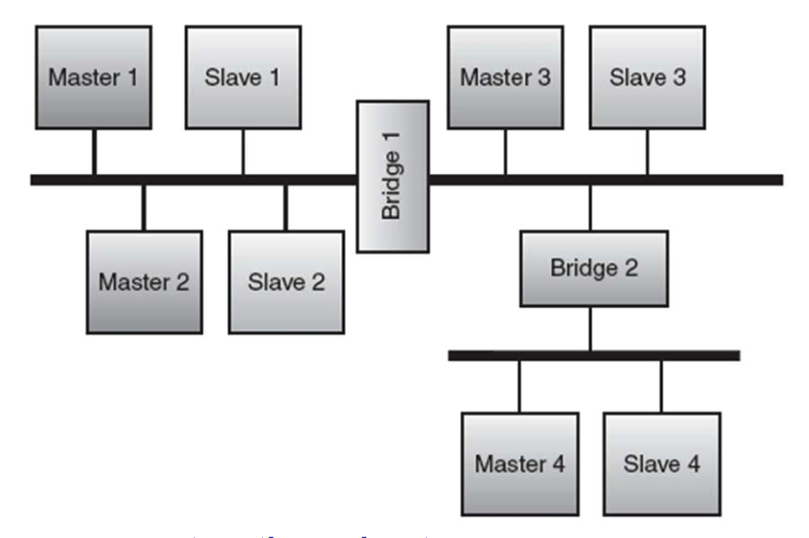
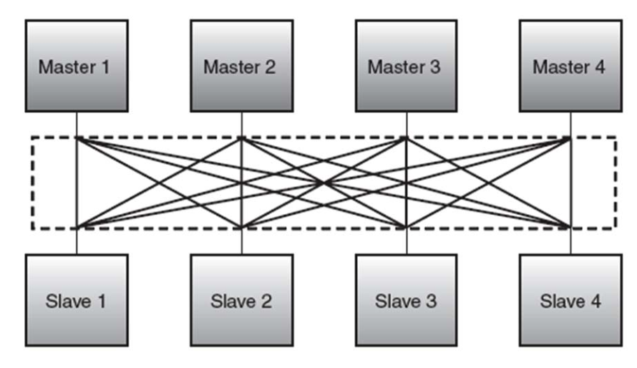
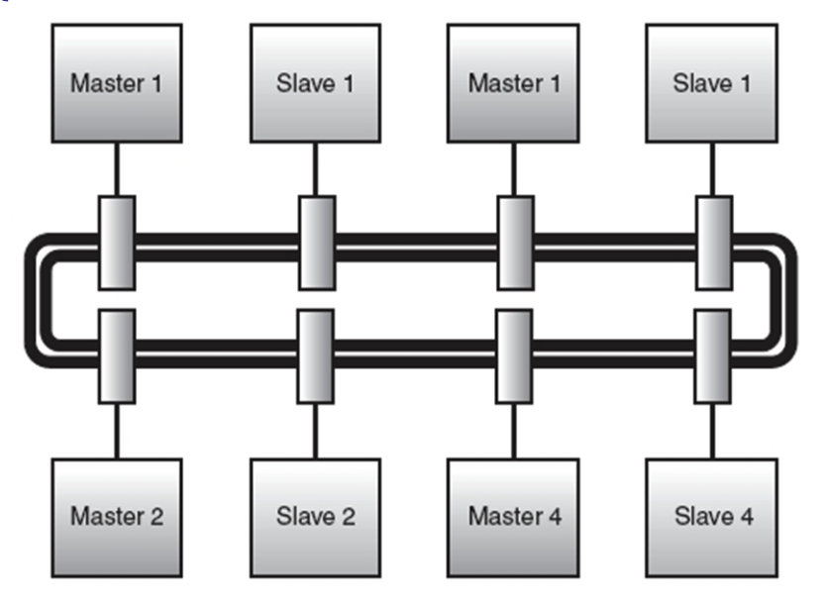
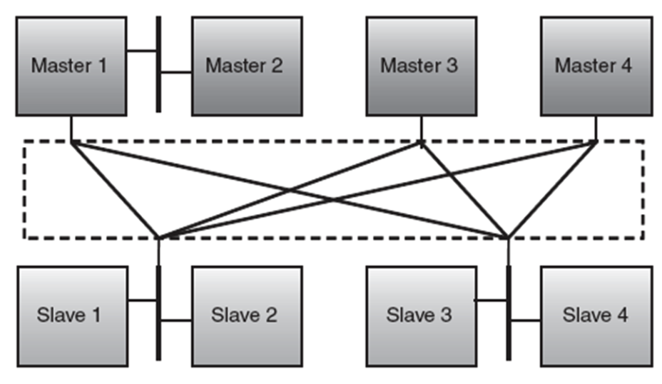
Bus Topologies
Hierarchical shared bus for different clock SoCs
Fully/partially Crossbar matrix
Ring bus

Slide 13
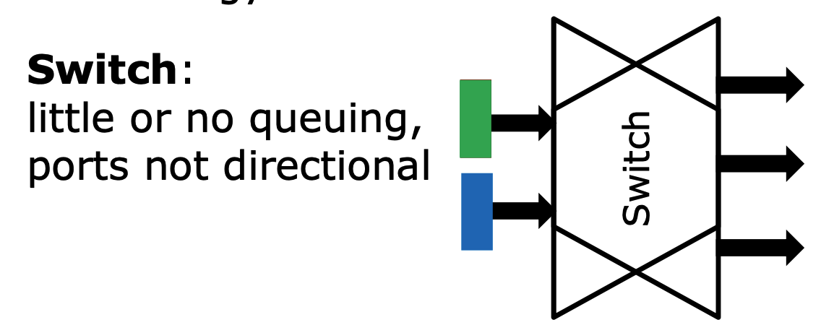
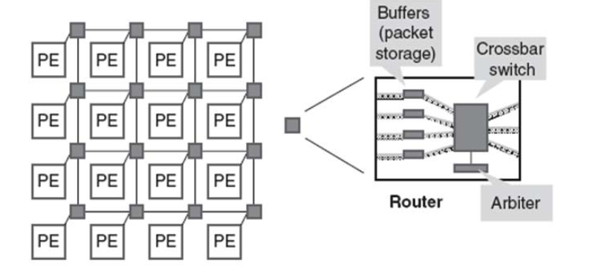
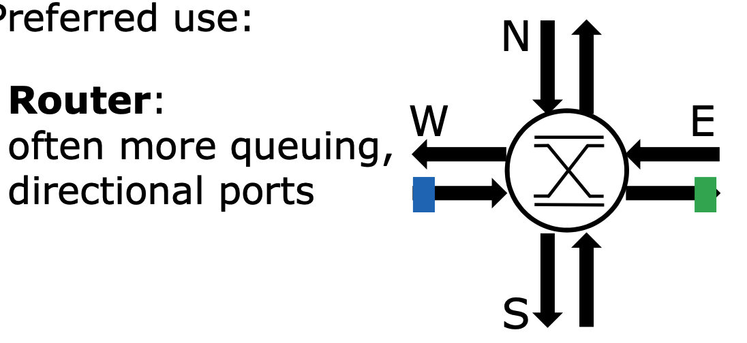
Networks-on-Chips (NoCs)
Network-on-chips is a packet switch based on-chip interconnection schemes designed by a layered methodology. “route-packets, not wires”
NoCs use packets to route data from the source to destination PE via a network fabric that consists of routers, as well as links.

Slide 14
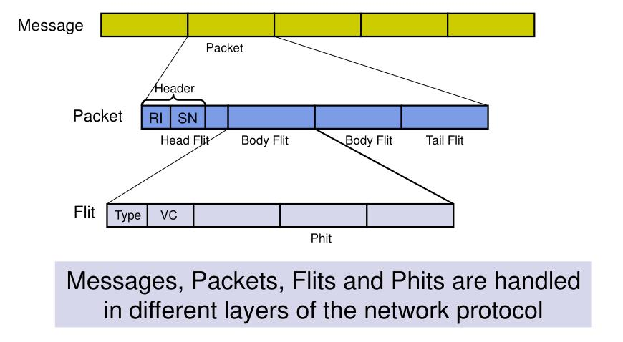
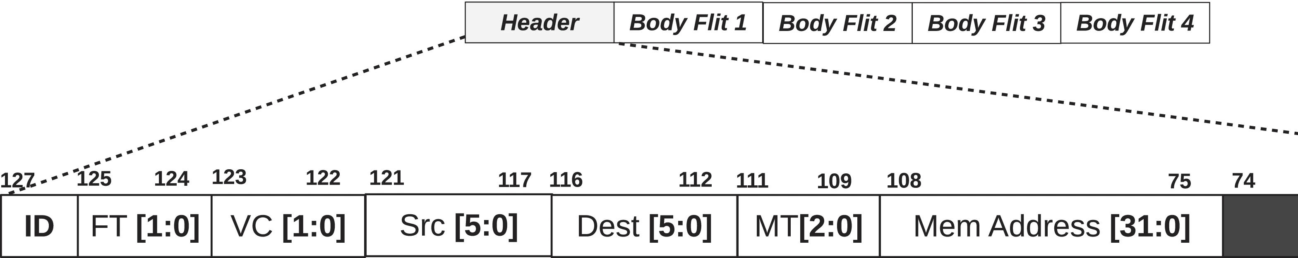
Packet and Flit
Each core sent messages/packets including information how data flows through routers in the NoC.
Phit (Physical control digit) is a unit of data that is transferred on a link.
Flit (flow control digit) is unit of switching.

Slide 15
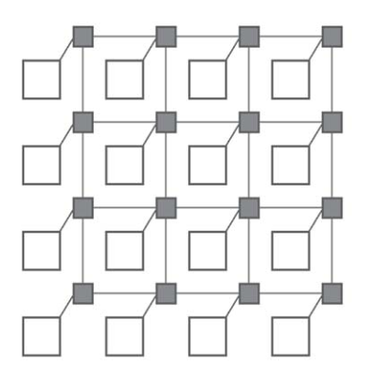
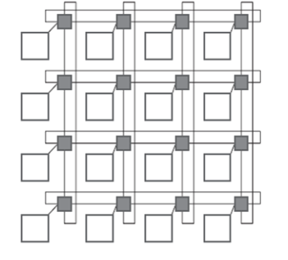
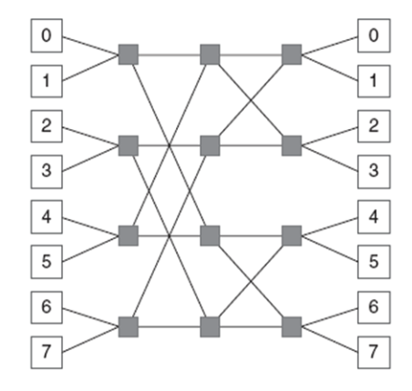
NoC Topologies
NoC is kind of an advanced bus, which is more friendly on scalable architectures.
Many NoC Topologies is used: 2D mesh, Torus, butterfly, fat-tree,…
Torus : Ring connection for nodes at the edges, long end-around link
2D Mesh: equivalent link length
Butterfly

Slide 16
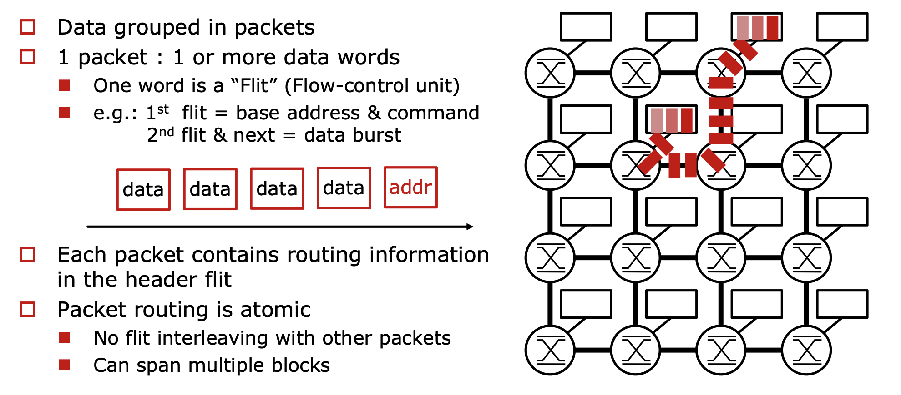
Routing: Packet-Switched Based Interconnect
Courtesy by Y. Thonnart, ISSCC 2021 Tutorial 8

Slide 17
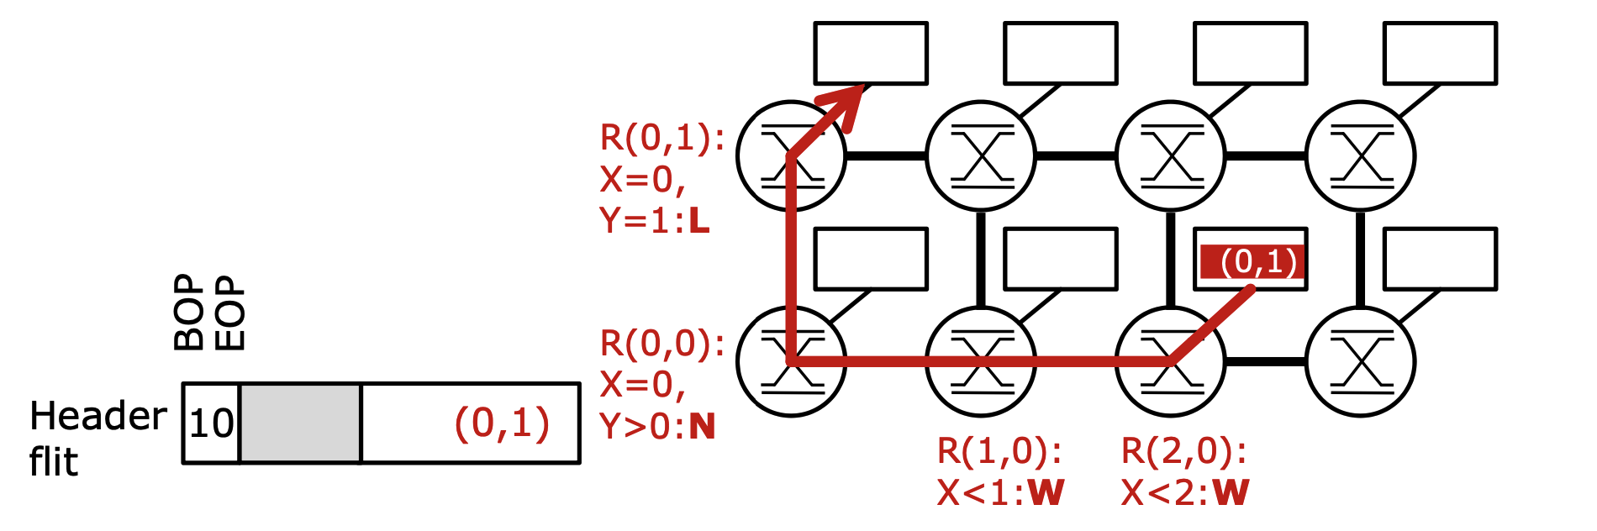
Routing & Packet Format
In 2D mesh NoC, Coordinates-based Routing is most commonly used
Destination coordinates is located in header
Comparison to Router coordinates for X-Y routing
Other methods includes indicate sequence of turning encoded in header flit
“East East North Local” …

Slide 18
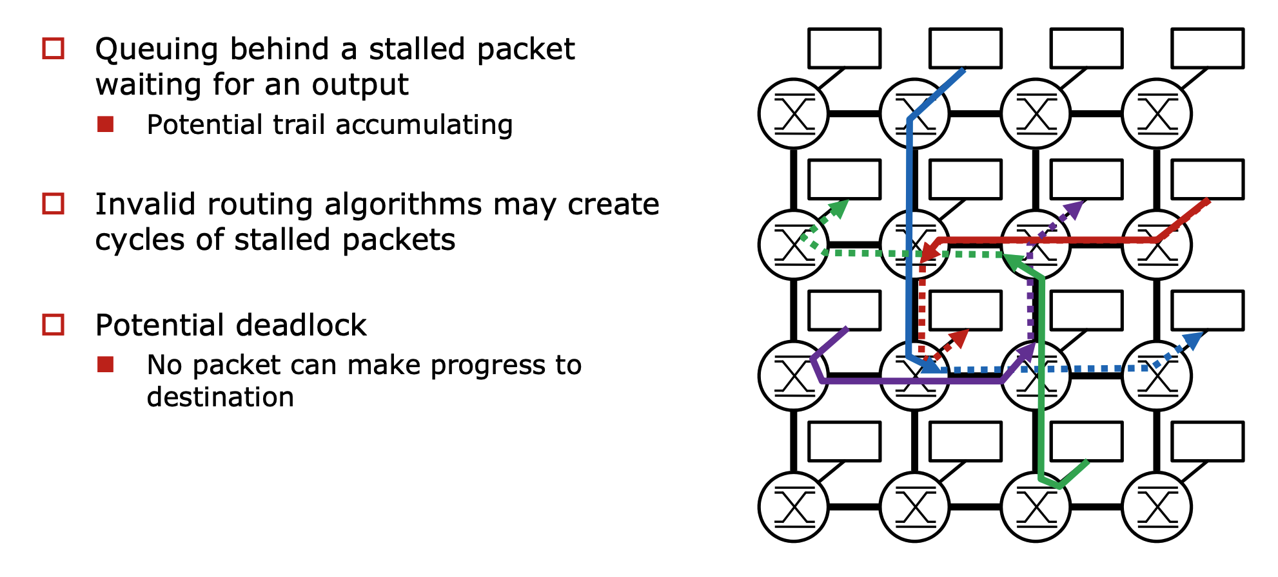

Routing: Traffic and deadlock
Courtesy by Y. Thonnart, ISSCC 2021 Tutorial 8

Slide 19
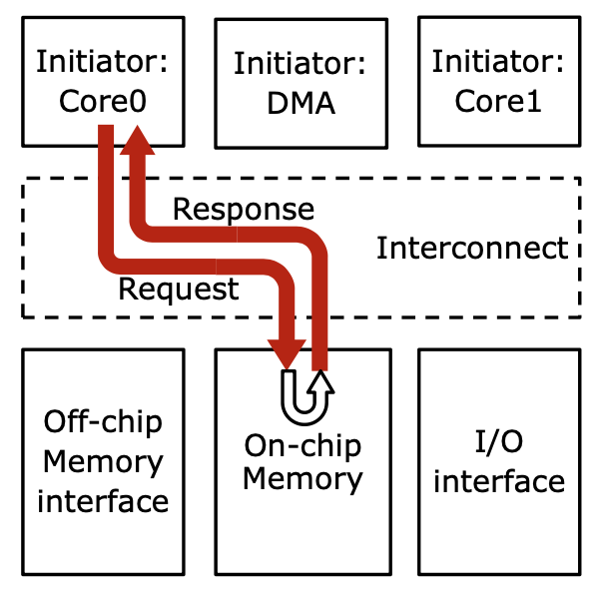
Transaction-based Interconnect
Memory access is another common type interconnect, which normally use transaction based interconnect.
Normally memory have specific protocols
Memory Request/Response have different/independent channels, therefore multiple request are allowed.
Memory Interconnect issues: coherence in multi-core architecture
AMBA 5: CHI ( Coherent Hub Interface)

Slide 20
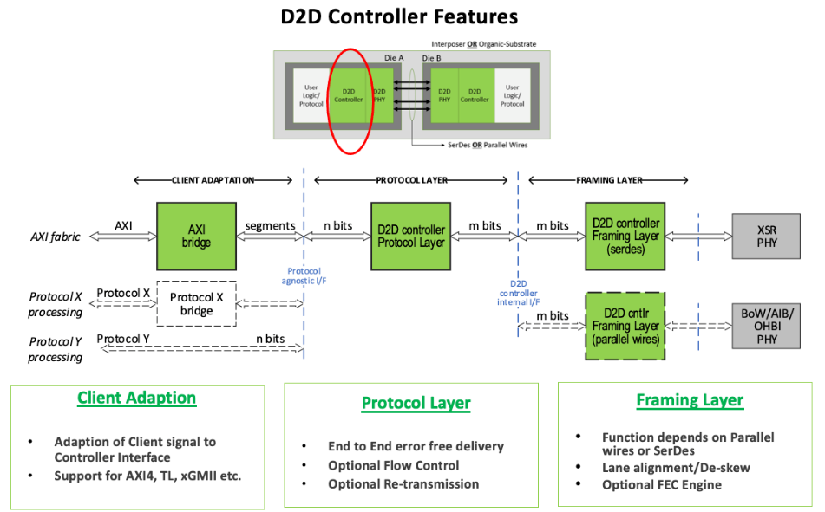
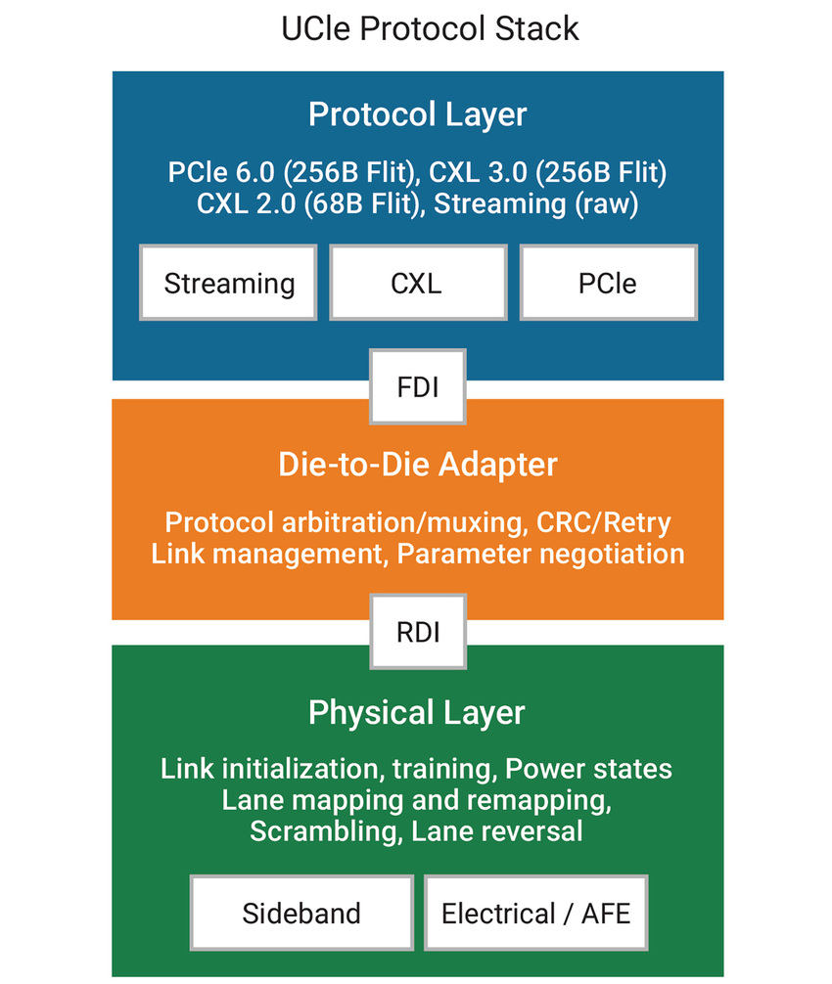
From Bus/NoC to Off-Chip Interconnect
Protocol Layer
Adpater
PHY Layer

Slide 21
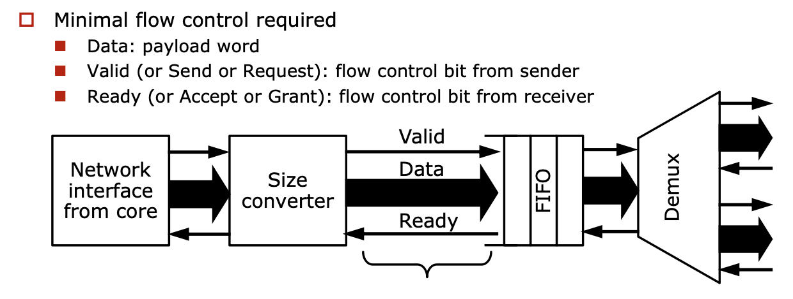
Transaction/Packet Based Interconnect
are naturally good protocol supporting inter-chiplet interconnect.

Slide 22
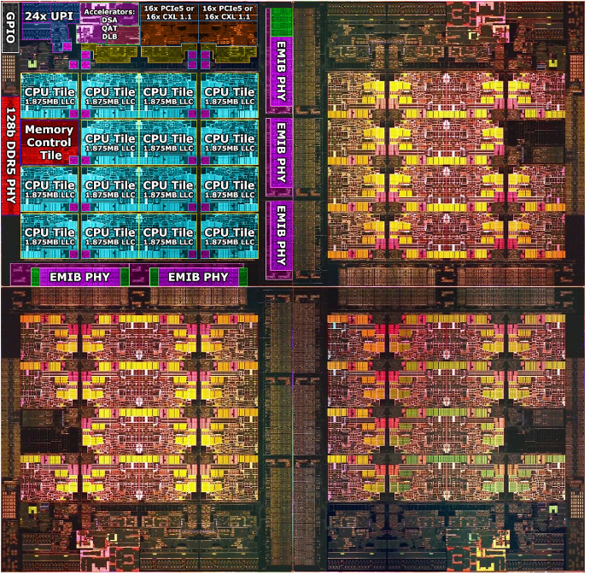
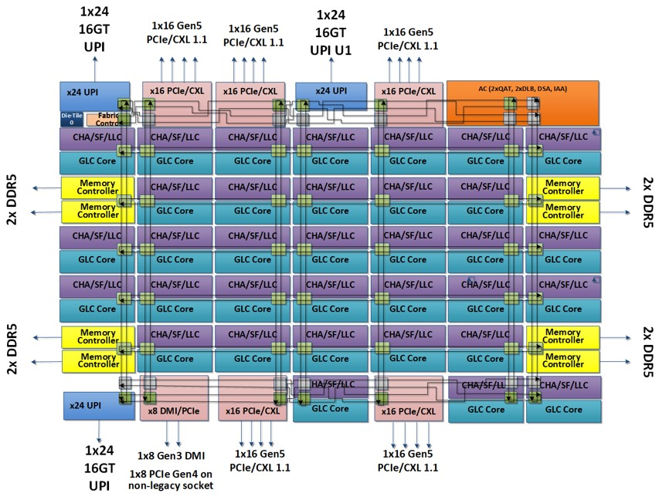
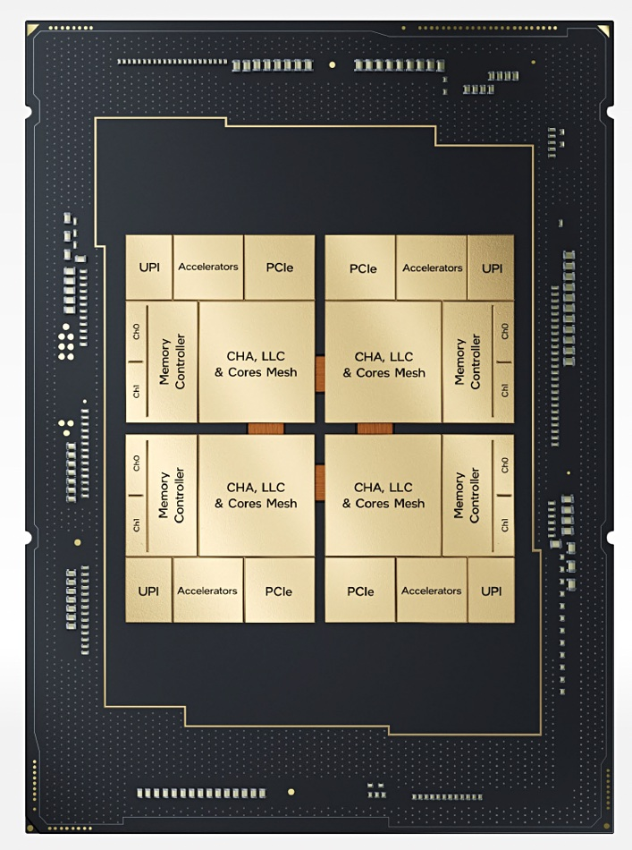
Case Study: NoC Partition with Multiple Chiplets
Intel Sapphire Rapids
4xCPU die(15 core each die) + 2D Mesh NoC
MCM Direct Connection with EMIB

Slide 23
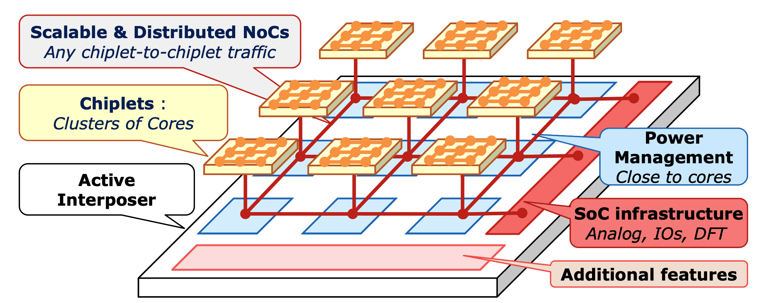
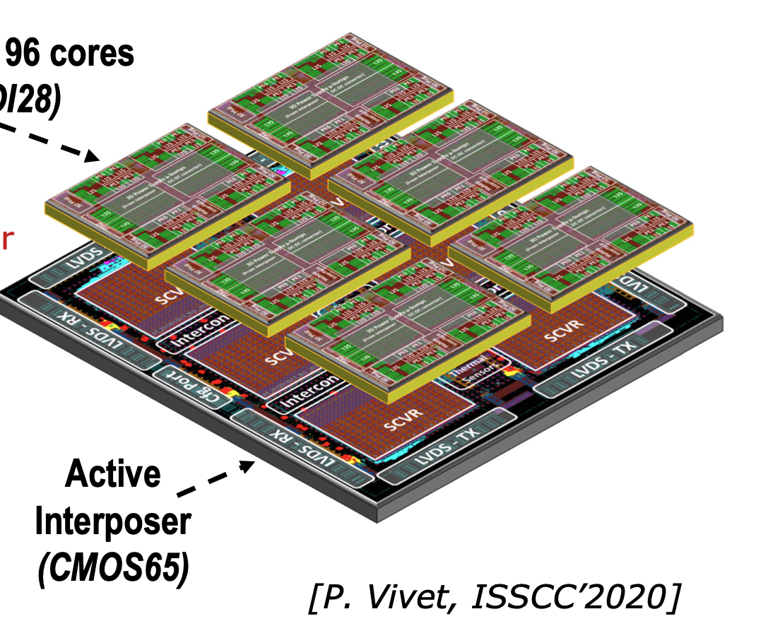
Case Study: NoC Partition with Multiple Chiplets
Cea-Leti: IntACT-Active Interposer with 6 chiplets and 96 cores
3-layer of distributed interconnect: On-chiplet 2D Mesh, short distance (Synchronous NoC) and long distance (Asynchronous NoC).

Slide 24
How advanced Packaging affects Interconnect?
Given a 1466 TFLOPS @ FP8 AI processor with 64MB on-chip weight buffer storage (similar to Nvidia L40S), Please estimate the overall token rate when it is deployed to complete a 7-billion LLAMA-2 model inference (FP8). Assumed the overall model is buffered in (a) a 48GB GDDR6 external DRAM, (b) 80GB HBM2e .

Slide 25
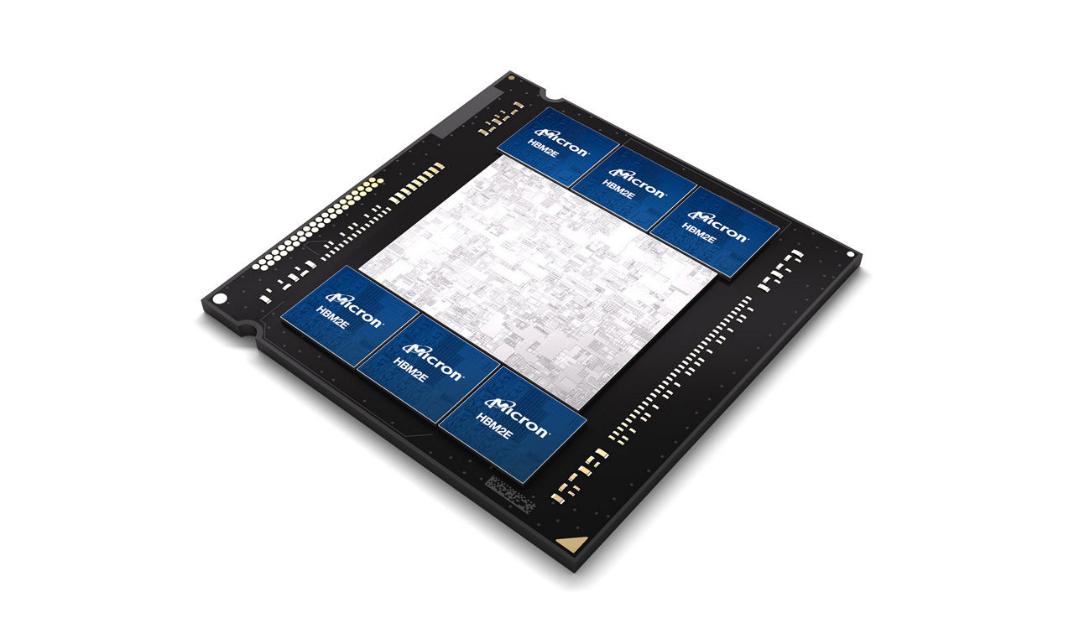
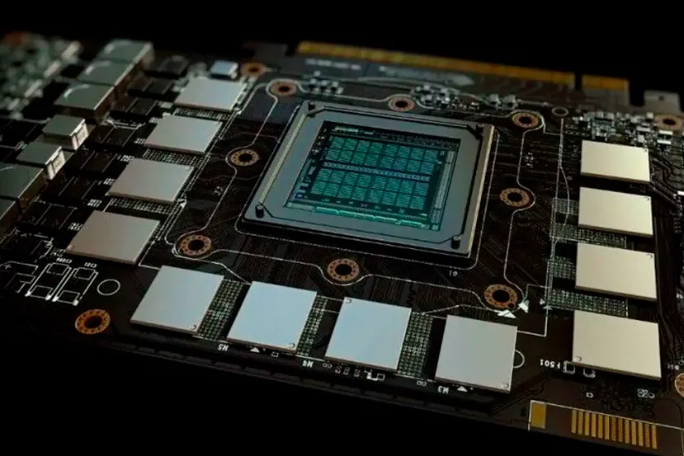
How advanced Packaging affects Interconnect?
 | GDDR 6 – 48GB | HBM 2E – 80GB
Per Pin Data Rate | 16 Gbps | 3.2Gbps
Data Pin Count Per Bank | 32 | 1024
Per bank bandwidth | 64 GBps | 409.6 GBps
Bank Number | 12 | 6
Overall Memory Bandwidth | 864 GBps | ~2040 GBps (with little loss)

